Slide 1
AI-led business process automation

Slide 2

Abstract and learning objectives
In this whiteboard design session, you will work in a group to automate the business process of extracting data from form documents and perform visit audio transcription (and translation where required) to extract and label medical information. You will evaluate Azure tools and services to design an optimal architecture to fulfill Contoso Healthcare's business process automation requirements.
At the end of this whiteboard design session, you will be better able to architect a solution to automate and enrich an existing business process and provide further insight into data using Azure Cognitive Services.

Slide 3
Step 1: Review the customer case study
Outcome
Analyze your customer needs.
Timeframe
15 minutes

Slide 4

Customer situation - 1
Contoso Healthcare is a major hospital network consisting of multiple locations across the United States.
Contoso Healthcare is looking to automate their business processes and redirect their employees to more impactful tasks to increase overall productivity.
Notes:
Contoso Healthcare is a major hospital network consisting of multiple locations across the United States.
Contoso Healthcare is looking to automate their business processes and redirect their employees to more impactful tasks to increase overall productivity.

Slide 5
Customer situation - 2
Employees review medical claims forms and enter data manually into the claims system.
Non standard use of patient/doctor visit audio recordings across hospitals and the ability to extract insights from the audio.
Need the ability to interpret medical claims spending at a glance through data visualizations.
Notes:
One of Contoso Healthcare's most significant needs is to have the ability to process handwritten and electronically filled medical claims forms. Each hospital needs to provide filled forms to Contoso Healthcare's central offices in a standard fashion. Currently, claims forms are completed as both digital files and physical paper documents. Employees then review each document and enter data manually into the claims system. Contoso Healthcare is looking to automate the business process of obtaining claim forms, extracting claims form data to reduce overall form processing time, data-entry errors, and the loss of physical documents. Contoso can also then re-direct their employees to more impactful tasks and increase overall productivity.
In addition to medical claims form processing, Contoso is looking to automate the process of transcribing, translating, and storing patient/doctor visit audio recordings. Currently, each hospital records audio files of patient/physician visits. This data is archived on-premises at each hospital and used strictly as an auditing tool should the details of any visit be questioned. When the results of a patient visit are challenged, the recording of the visit is retrieved and audibly reviewed by hospital employees. Unfortunately, this manual review process is not standard across the hospital network. As a result, each hospital has its own methods of dealing with patient audio file storage, retrieval, and review. A translation may also be needed in addition to patient audio transcription when the visit language is Spanish. Currently, multiple language interpreters need to be on-hand at each hospital for the manual audio review process.
Contoso Healthcare wants to implement useful reporting visualizations over the extracted claims processing data, such as visualizing the ratio of total cost and the amount covered for a patient. Doctors are also interested in extracting critical insights from the patient visit audio transcriptions, preferably via search functionality available on their internal portal site.

Slide 6
Customer needs - 1
Claims forms and patient visit audio files need to be obtained from each hospital in the network consistently.
An automated process should extract data from claims forms submitted.
A report needs to be created to provide a visualization on total charges versus the amount paid for a specified date range obtained from claims form processing.
Notes:
Claims forms and patient visit audio files need to be obtained from each hospital in the network consistently.
An automated process should extract data from claims forms submitted.
A report needs to be created to provide a visualization on total charges versus the amount paid for a specified date range obtained from claims form processing.

Slide 7
Customer needs - 2
4. Audio of the patient visit must be transcribed.
5. If the patient visit audio is in Spanish, transcribed text must be translated into English (en-US).
6. Transcribed patient audio and claims forms must be made searchable from the internal web portal.
7. The process of extracting and storing data from claims forms and obtaining audio transcription from patient visits needs to be automated.
Notes:
4. Audio of the patient visit must be transcribed.
5. If the patient visit audio is in Spanish, transcribed text must be translated into English (en-US).
6. Transcribed patient audio and claims forms must be made searchable from the internal web portal.
7. The process of extracting and storing data from claims forms and obtaining audio transcription from patient visits needs to be automated.

Slide 8

Customer objections
Claims forms are filled out either electronically or are handwritten. We have a concern that handwritten input will not be able to be processed.
Patient visit audio may involve conversations in languages other than English. We need a solution that can identify and translate from Spanish into English (en-US). Additional languages might be needed as the network spans to other regions.
We want to extract insight from the audio transcriptions of patient visits through our internal portal searches. However, we don't have a data dictionary of medical terms. Is there a solution to analyze our audio transcripts to surface medical terminologies, such as dosages, medications, and diagnoses?
Notes:
Claims forms are filled out either electronically or are handwritten. We have a concern that handwritten input will not be able to be processed.
Patient visit audio may involve conversations in languages other than English. We need a solution that can identify and translate from Spanish into English (en-US). Additional languages might be needed as the network spans to other regions.
We want to extract insight from the audio transcriptions of patient visits through our internal portal searches. However, we don't have a data dictionary of medical terms. Is there a solution to analyze our audio transcripts to surface medical terminologies, such as dosages, medications, and diagnoses?

Slide 9
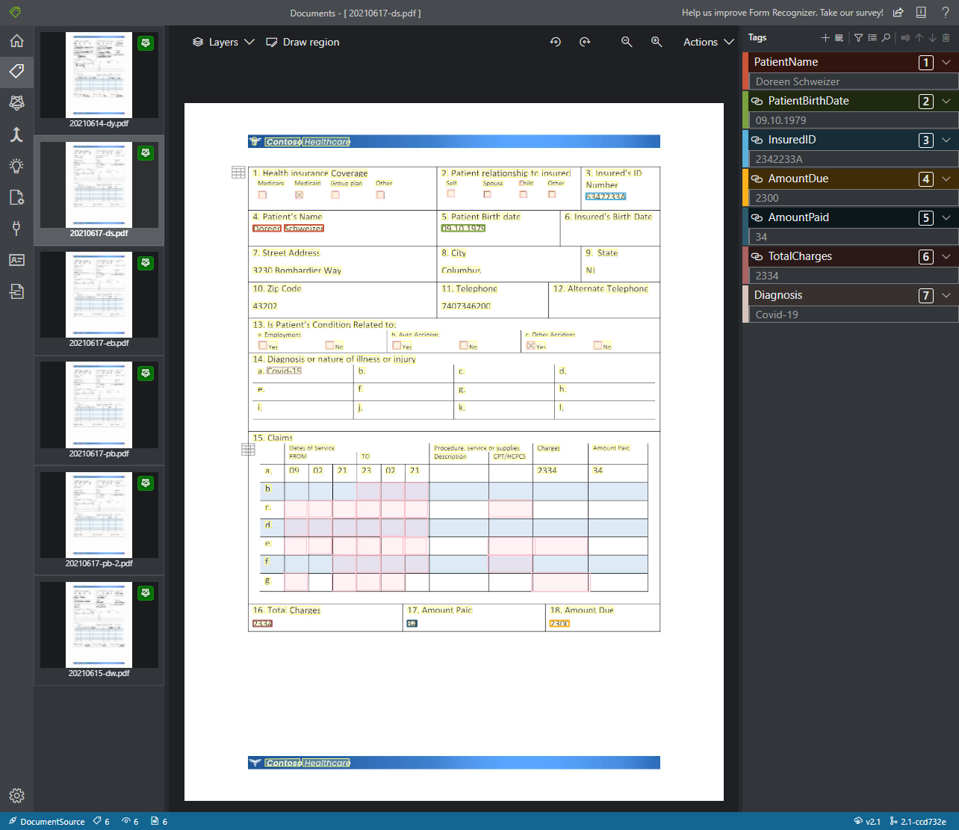
Common scenarios - 1
The Azure Form Recognizer sample labeling tool assists with the creation of custom models to extract information from a form.
Notes:
An example of a common scenario is using the sample labeling tool with Azure Form Recognizer to create a custom model to extract information from a form.

Slide 10
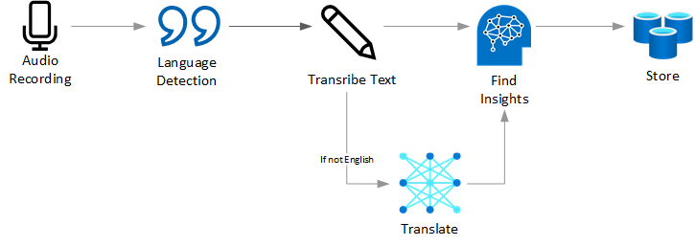
Common scenarios - 2
A sample speech-to-text processing flow.
Notes:
A speech-to-text processing flow shows an input of an audio recording having it's language detected followed by transcription. This text will then be forwarded on to be translated if necessary, then provided to cognitive services to extract insights. Finally the data is persisted to storage.

Slide 11
Step 2: Design the solution
Outcome
Design a solution and prepare to present the solution to the target customer audience in a 15-minute chalk-talk format.
Timeframe
60 minutes
Business needs (10 minutes) | Respond to questions outlined in your guide and be prepared to present your solutions to others.
Design (35 minutes) | Design a solution for as many of the stated requirements as time allows.
Prepare (15 minutes) | Identify any customer needs that are not addressed with the proposed solution. Identify the benefits of your solution. Determine how you will respond to the customer’s objections. Prepare for a 15-minute presentation to the customer.

Slide 12
File ingestion - 1
Each hospital must submit claims forms in a consistent manner. How do you suggest having each hospital provide claims forms for automated centralized processing?
Each hospital must provide patient audio files in a consistent manner. How do you suggest each hospital provide audio files for automated centralized processing? Does this differ from the method you suggested for claims forms? If so, why?
Audio and claim form files need to be stored centrally. What type of structure do you recommend to organize these incoming files?
Notes:
Each hospital must submit claims forms in a consistent manner. How do you suggest having each hospital provide claims forms for automated centralized processing?
Each hospital must provide patient audio files in a consistent manner. How do you suggest each hospital provide audio files for automated centralized processing? Does this differ from the method you suggested for claims forms? If so, why?
Audio and claim form files need to be stored centrally. What type of structure do you recommend to organize these incoming files?

Slide 13
File ingestion - 2
4. The business process of extracting and storing claims form data and audio transcriptions must be automated. What do you recommend to trigger and orchestrate this processing, so that manual intervention is not required?
5. Once a claim form or audio file has been processed, how do you ensure that they do not get processed multiple times?
Notes:
4. The business process of extracting and storing claims form data and audio transcriptions must be automated. What do you recommend to trigger and orchestrate this processing, so that manual intervention is not required?
5. Once a claim form or audio file has been processed, how do you ensure that they do not get processed multiple times?

Slide 14
Form processing
What Azure service do you recommend to extract data from the claims forms? Are there any tools that can be used to simplify this process?
How do you recommend storing the data extracted from the claims forms?
Notes:
What Azure service do you recommend to extract data from the claims forms? Are there any tools that can be used to simplify this process?
How do you recommend storing the data extracted from the claims forms?

Slide 15
Reporting
1. What Azure service do you recommend for the creation of reports to visualize data extracted from both the claims forms and audio transcriptions?
Notes:
What Azure service do you recommend for the creation of reports to visualize data extracted from both the claims forms and audio transcriptions?

Slide 16
Audio Transcription and translation
What Azure service do you recommend for transcribing patient visit audio files?
How would you identify the spoken language of the visit?
What Azure service would you use to translate audio transcriptions to English (en-US)?
How do you recommend storing the audio transcription?
In case of an audit, how would you be able to track down the original source audio file for a specific transcription?
Notes:
What Azure service do you recommend for transcribing patient visit audio files?
How would you identify the spoken language of the visit?
What Azure service would you use to translate audio transcriptions to English (en-US)?
How do you recommend storing the audio transcription?
In case of an audit, how would you be able to track down the original source audio file for a specific transcription?

Slide 17
Search indexing, enrichment, and implementation - 1
What Azure service do you recommend to index the audio transcription data to make them searchable?
How do you recommend keeping the index up-to-date when transcripts are added over time?
What Azure service do you recommend to enrich the search index to extract medical insights?
Notes:
What Azure service do you recommend to index the audio transcription data to make them searchable?
How do you recommend keeping the index up-to-date when transcripts are added over time?
What Azure service do you recommend to enrich the search index to extract medical insights?

Slide 18
Search indexing, enrichment, and implementation - 2
4. What Azure service do you recommend to rank search results based on the search criteria or to identify questions that may be asked and provide direct answers?
5. What steps must be taken to implement the audio transcription search to the internal web portal?
Notes:
4. What Azure service do you recommend to rank search results based on the search criteria or to identify questions that may be asked and provide direct answers
5. What steps must be taken to implement the audio transcription search to the internal web portal?

Slide 19
High-level architecture
1. Based on your answers to the questions above, diagram a high-level architecture for the initial vision of handling file ingestion, form processing, reporting, audio transcription/translation, as well as search indexing, enhancement, and implementation.
Notes:
1. Based on your answers to the questions above, diagram a high-level architecture for the initial vision of handling file ingestion, form processing, reporting, audio transcription/translation, as well as search indexing, enhancement, and implementation.

Slide 20
Step 3: Present the solution
Outcome
Present a solution to the target customer in a 15-minute chalk-talk format.
Timeframe
30 minutes (15 minutes for each team to present and receive feedback)
Directions
Pair with another team.
One group is the Microsoft team and the other is the customer.
The Microsoft team presents their proposed solution to the customer.
The customer asks one of the objections from the list of objections in the case study.
The Microsoft team responds to the objection.
The customer team gives feedback to the Microsoft team.
Switch roles and repeat Steps 2-6.

Slide 21
Wrap-up
Outcome
Identify the preferred solution for the case study.
Identify solutions designed by other teams.
Timeframe
15 minutes

Slide 22

Preferred target audience
Senaabil Chandi, CTO of Contoso Healthcare.
The primary audience is business and technology decision-makers.
Usually, we talk to the Infrastructure Managers who report to the CIOs, or application sponsors (like a VP LOB, CMO), or to those that represent the Business Unit IT or developers that report into application sponsors.
Notes:
Senaabil Chandi, CTO of Contoso Healthcare
The primary audience is the business decision makers and technology decision makers. Usually, we talk to the infrastructure managers who report to the chief information officers (CIOs), or to application sponsors (like a vice president [VP] line of business [LOB], or to those who represent the business unit IT or developers that report to application sponsors.

Slide 23
Preferred solution – File ingestion - 1
1. Each hospital must submit claims forms in a consistent manner. How do you suggest having each hospital provide claims forms for automated centralized processing?
Each hospital should deliver claims forms digitally. This means that any handwritten forms should be scanned and provided as digital files. These files should be uploaded to an Azure Storage Account. In order to simplify the upload process, the Azure Files service can be used to expose the storage account as a network file share. It is essential at this level to remove the handling of paper forms and proceed with a 100% digital process.
Notes:
Each hospital must submit claims forms in a consistent manner. How do you suggest having each hospital provide claims forms for automated centralized processing?
Each hospital should deliver claims forms digitally. This means that any handwritten forms should be scanned and provided as digital files. These files should be uploaded to an Azure Storage Account. In order to simplify the upload process, the Azure Files service can be used to expose the storage account as a network file share. It is essential at this level to remove the handling of paper forms and proceed with a 100% digital process.

Slide 24
Preferred solution – File ingestion - 2
2. Each hospital must provide patient audio files in a consistent manner. How do you suggest each hospital provide audio files for automated centralized processing? Does this differ from the method you suggested for claims forms? If so, why?
It is recommended to keep uploading of files consistent. Each hospital should use the same method to upload audio files as it does the claims forms.
Notes:
2. Each hospital must provide patient audio files in a consistent manner. How do you suggest each hospital provide audio files for automated centralized processing? Does this differ from the method you suggested for claims forms? If so, why?
It is recommended to keep uploading of files consistent. Each hospital should use the same method to upload audio files as it does the claims forms.

Slide 25
Preferred solution – File ingestion - 3
3. Audio and claim form files need to be stored centrally. What type of structure do you recommend to organize these incoming files?
There are multiple valid approaches to file organization. When using batch processing, a common approach is to use the following structure (subject matter could be "claimsform" or "visitaudio"):
{Hospital}/{SubjectMatter}/In/{yyyy}/{mm}/{dd}/{hh}/
{Hospital}/{SubjectMatter}/Out/{yyyy}/{mm}/{dd}/{hh}/
{Hospital}/{SubjectMatter}/Bad/{yyyy}/{mm}/{dd}/{hh}/
Using this structure, files land in the "in" directory, and when processed, the new data is placed in the "out" directory. Should the processing of a file fail, it can be moved into a "bad" folder for further review.
Notes:
3. Audio and claim form files need to be stored centrally. What type of structure do you recommend to organize these incoming files
There are multiple valid approaches to file organization. When using batch processing, a common approach is to use the following structure (subject matter could be "claimsform" or "visitaudio"):
{Hospital}/{SubjectMatter}/In/{yyyy}/{mm}/{dd}/{hh}/
{Hospital}/{SubjectMatter}/Out/{yyyy}/{mm}/{dd}/{hh}/
{Hospital}/{SubjectMatter}/Bad/{yyyy}/{mm}/{dd}/{hh}/
Using this structure, files land in the "in" directory, and when processed, the new data is placed in the "out" directory. Should the processing of a file fail, it can be moved into a "bad" folder for further review.

Slide 26
Preferred solution – File ingestion - 4
4. The business process of extracting and storing claims form data and audio transcriptions must be automated. What do you recommend to trigger and orchestrate this processing so that manual intervention is not required?
Similar to file organization, multiple approaches to process triggering also exist. You can use timer triggers in Azure Functions, schedule triggers in Azure Logic Apps, and even scheduled triggers for an Azure Synapse Analytics pipeline. You also can utilize event-based triggers. An example of an event-based trigger is to use Event Grid that can identify the storage account as an event source and watch for the BlobCreated event. This event can initiate the execution of an Azure Function that begins processing the file that was added to storage.
Notes:
4. The business process of extracting and storing claims form data and audio transcriptions must be automated. What do you recommend to trigger and orchestrate this processing so that manual intervention is not required?
Similar to file organization, multiple approaches to process triggering also exist. You can use timer triggers in Azure Functions, schedule triggers in Azure Logic Apps, and even scheduled triggers for an Azure Synapse Analytics pipeline. You also can utilize event-based triggers. An example of an event-based trigger is to use Event Grid that can identify the storage account as an event source and watch for the BlobCreated event. This event can initiate the execution of an Azure Function that begins processing the file that was added to storage.

Slide 27
Preferred solution – File ingestion - 5
5. Once a claim form or audio file has been processed, how do you ensure that they do not get processed multiple times?
When using the batch processing in/out/bad approach, the result of the processing is idempotent, meaning that if the files do end up getting processed multiple times, it will result in unchanged values. The results in the "out" folder will remain the same. Data will not be added or removed as long as the "in" folder files are unchanged. When it comes to individual file processing, moving the file to some type of processed or archive location is recommended to ensure that it does not get processed multiple times. If the output data is saved into a database, it is vital to make sure the implementation is idempotent.
Notes:
5. Once a claim form or audio file has been processed, how do you ensure that they do not get processed multiple times?
When using the batch processing in/out/bad approach, the result of the processing is idempotent, meaning that if the files do end up getting processed multiple times, it will result in unchanged values. The results in the "out" folder will remain the same. Data will not be added or removed as long as the "in" folder files are unchanged. When it comes to individual file processing, moving the file to some type of processed or archive location is recommended to ensure that it does not get processed multiple times. If the output data is saved into a database, it is vital to make sure the implementation is idempotent.

Slide 28
Preferred solution – Form processing - 1
What Azure service do you recommend to extract data from the claims forms? Are there any tools that can be used to simplify this process?
Azure Form Recognizer can be used to train a custom model to extract information from a form. The sample labeling tool can be used to provide an intuitive user interface to identify the regions of the form from where data should be extracted, resulting in a supervised learning model that can be used to extract data from subsequent forms. Training should take place with a minimum of 5 samples when using supervised (labeled) learning.
Notes:
Link to sample labeling tool: https://docs.microsoft.com/azure/cognitive-services/form-recognizer/label-tool?tabs=v2-1
What Azure service do you recommend to extract data from the claims forms? Are there any tools that can be used to simplify this process?
Azure Form Recognizer can be used to train a custom model to extract information from a form. The sample labeling tool can be used to provide an intuitive user interface to identify the regions of the form from where data should be extracted, resulting in a supervised learning model that can be used to extract data from subsequent forms. Training should take place with a minimum of 5 samples when using supervised (labeled) learning.

Slide 29
Preferred solution – Form processing - 2
2. How do you recommend storing the data extracted from the claims forms?
The result of the data extraction process using the Form Recognizer yields JSON documents. This data can be further processed and stored in a relational database, the results can be saved to a storage account as files, or they can be stored as documents in a NoSQL type of database, like Cosmos DB.
Notes:
2. How do you recommend storing the data extracted from the claims forms?
The result of the data extraction process using the Form Recognizer yields JSON documents. This data can be further processed and stored in a relational database, the results can be saved to a storage account as files, or they can be stored as documents in a NoSQL type of database, like Cosmos DB.

Slide 30
Preferred solution - Reporting
What Azure service do you recommend for the creation of reports to visualize data extracted from the claims forms?
Power BI is a collection of software services, apps, and connectors that work together to turn your unrelated data sources into coherent, visually immersive, and interactive insights. The data can be sourced from various cloud-based services, such as Azure Storage and Cosmos DB.
Notes:
What Azure service do you recommend for the creation of reports to visualize data extracted from the claims forms?
Power BI is a collection of software services, apps, and connectors that work together to turn your unrelated data sources into coherent, visually immersive, and interactive insights. The data can be sourced from various cloud-based services, such as Azure Storage and Cosmos DB.

Slide 31
Preferred solution – Audio transcription and translation - 1
What Azure service do you recommend for transcribing patient visit audio files?
Azure Speech Service provides APIs to transcribe from audio files, either individually or in batch.
2. How would you identify the spoken language of the visit?
Language identification is available using the Speech Service speech-to-text APIs. Alternatively, language identification is also available for transcribed text using Azure Text Analytics APIs.
Notes:
Links:
Speech Service API: https://docs.microsoft.com/azure/cognitive-services/speech-service/speech-translation
Azure Text Analytics API: https://docs.microsoft.com/azure/cognitive-services/text-analytics/how-tos/text-analytics-how-to-language-detection
What Azure service do you recommend for transcribing patient visit audio files?
Azure Speech Service provides APIs to transcribe from audio files, either individually or in batch.
2. How would you identify the spoken language of the visit?
Language identification is available using the Speech Service speech-to-text APIs. Alternatively, language identification is also available for transcribed text using Azure Text Analytics APIs.

Slide 32
Preferred solution – Audio transcription and translation - 2
3. What Azure service would you use to translate audio transcriptions to English (en-US)?
The Azure Speech service provides translation in speech-to-text as well as speech-to-speech. The Microsoft Translator service can also be leveraged to accomplish the same goal. Speech translation, powered by Translator, is also available through the Azure Speech service. It combines functionality from the Translator Speech API and the Custom Speech Service into a unified and fully customizable service. In addition to speech translation, The Microsoft Translator service also offers text and document translation.
Notes:
Links:
Azure Speech service: https://docs.microsoft.com/azure/cognitive-services/speech-service/speech-translation
Microsoft Translator service: https://docs.microsoft.com/azure/cognitive-services/translator/translator-info-overview
3. What Azure service would you use to translate audio transcriptions to English (en-US)?
The Azure Speech service provides translation in speech-to-text as well as speech-to-speech. The Microsoft Translator service can also be leveraged to accomplish the same goal. Speech translation, powered by Translator, is also available through the Azure Speech service. It combines functionality from the Translator Speech API and the Custom Speech Service into a unified and fully customizable service. In addition to speech translation, The Microsoft Translator service also offers text and document translation.

Slide 33
Preferred solution – Audio transcription and translation - 3
4. How do you recommend storing the audio transcription?
The audio transcription can be stored in the same type of data store as the form data extraction (Cosmos DB).
5. In the case of an audit, how would you be able to track down the original source audio file for a specific transcription?
Adding metadata fields to help with data lineage, such as processing date and path to the originating source file is recommended.
Notes:
4. How do you recommend storing the audio transcription?
The audio transcription can be stored in the same type of data store as the form data extraction (Cosmos DB).
5. In the case of an audit, how would you be able to track down the original source audio file for a specific transcription?
Adding metadata fields to help with data lineage, such as processing date and path to the originating source file is recommended.

Slide 34
Preferred solution – Search indexing, enrichment, and implementation - 1
1. What Azure service do you recommend to index the audio transcription data to make them searchable?
Azure Cognitive Search allows indexing for a wide variety of sources, including fields in Cosmos DB.
2. How do you recommend keeping the index up-to-date when transcripts are added over time?
Change detection is available for many indexers. In the case of Cosmos DB, the purpose of a data change detection policy is to identify changed data items efficiently. Currently, the only supported policy is the HighWaterMarkChangeDetectionPolicy using the _ts (timestamp) property in the case of indexing by Azure Cosmos DB. This helps with both performance for large datasets as well ensuring the index stays up to date. Re-indexing can be performed on a scheduled basis or initiated via an API call.
Notes:
What Azure service do you recommend to index the audio transcription data to make them searchable?
Azure Cognitive Search allows indexing for a wide variety of sources, including fields in Cosmos DB.
2. How do you recommend keeping the index up-to-date when transcripts are added over time?
Change detection is available for many indexers. In the case of Cosmos DB, the purpose of a data change detection policy is to identify changed data items efficiently. Currently, the only supported policy is the HighWaterMarkChangeDetectionPolicy using the _ts (timestamp) property in the case of indexing by Azure Cosmos DB. This helps with both performance for large datasets as well ensuring the index stays up to date. Re-indexing can be performed on a scheduled basis or initiated via an API call.

Slide 35
Preferred solution – Search indexing, enrichment, and implementation - 2
3. What Azure service do you recommend to enrich the search index to extract medical insights?
Text Analytics for health is a feature of the Text Analytics API service that extracts and labels relevant medical information from unstructured texts such as doctor's notes, discharge summaries, clinical documents, and electronic health records. Use this service as part of the AI enrichment pipeline in Azure Cognitive Search.
Notes:
Link:
AI Enrichment pipeline: https://docs.microsoft.com/azure/search/cognitive-search-concept-intro
3. What Azure service do you recommend to enrich the search index to extract medical insights?
Text Analytics for health is a feature of the Text Analytics API service that extracts and labels relevant medical information from unstructured texts such as doctor's notes, discharge summaries, clinical documents, and electronic health records. Use this service as part of the AI enrichment pipeline in Azure Cognitive Search.

Slide 36
Preferred solution – Search indexing, enrichment, and implementation - 3
4. What Azure service do you recommend to rank search results based on the search criteria or to identify questions that may be asked and provide direct answers?
Semantic search is a collection of features that improve the quality of search results. When enabled on your search service, it extends the query execution pipeline in two ways. First, it adds secondary ranking over an initial result set, promoting the most semantically relevant results to the top of the list. Second, it extracts and returns captions and answers in the response, which you can render on a search page to improve the user's search experience.
Notes:
4. What Azure service do you recommend to rank search results based on the search criteria or to identify questions that may be asked and provide direct answers?
Semantic search is a collection of features that improve the quality of search results. When enabled on your search service, it extends the query execution pipeline in two ways. First, it adds secondary ranking over an initial result set, promoting the most semantically relevant results to the top of the list. Second, it extracts and returns captions and answers in the response, which you can render on a search page to improve the user's search experience.

Slide 37
Preferred solution – Search indexing, enrichment, and implementation - 4
5. What steps must be taken to implement the audio transcription search to the internal web portal?
Many tutorials are available in the Cognitive Search documentation to implement search in web applications on multiple platforms.
Notes:
Links: https://docs.microsoft.com/azure/search/tutorial-csharp-overview
Tutorials:
4. What steps must be taken to implement the audio transcription search to the internal web portal?
Many tutorials are available in the Cognitive Search documentation to implement search in web applications on multiple platforms.

Slide 38
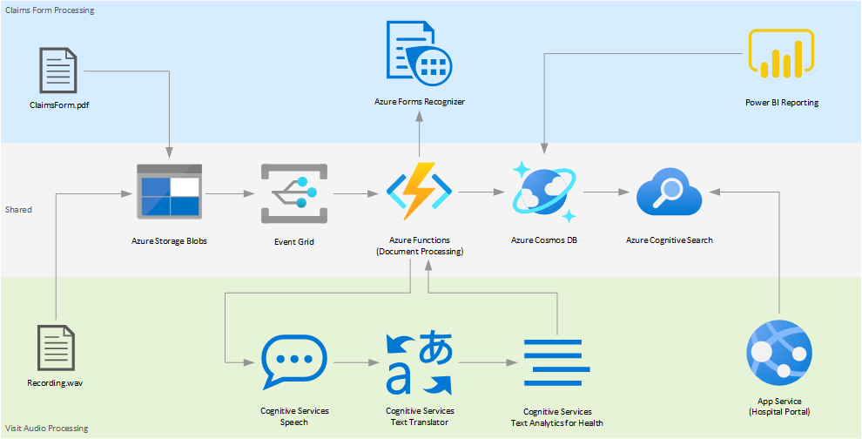
Preferred solution – High-level architecture
Notes:
Hospitals in the Contoso Healthcare network can upload PDF files of claim forms and WAV files of visit audio recordings to blobs in an Azure Storage account or Azure Files. Two event grid subscriptions propagate the blob creation events that trigger two separate functions in a Function App.
One of the functions handles PDF processing. The function uses an Azure Forms Recognizer that has a custom trainer model to extract the required information from forms. Once the metadata is extracted, the function saves the result in Azure CosmosDB, allowing Contoso to build custom PowerBI reports with a direct query connection. Additionally, the data is indexed in an Azure Cognitive Search to be served in a unified search experience on the internal hospital portal.
A second function in the Function App processes audio recordings. Contoso uses Azure Cognitive Speech Audio Language Identification to detect the language of the audio file and transcribe it to text. Once the text transcriptions are ready, Spanish transcriptions are translated to English using Azure Cognitive Services Text Translator. Finally, Azure Cognitive Services Text Analytics for Health is used to extract and label relevant medical information to provide a richer search experience in the internal hospital portal. Once the results are ready, the function saves the data in an Azure CosmosDB collection to be indexed by Azure Cognitive Search.
Finally, the internal hospital portal queries the indexes created in Azure Cognitive Search, offering a unified search experience for both structured and unstructured data sets.

Slide 39
Preferred objection handling - 1
1. Claims forms are filled out either electronically or are handwritten. We have a concern that handwritten input will not be able to be processed.
The Form Recognizer service can extract both digital and handwritten content.
2. Patient visit audio may involve conversations in languages other than English. We need a solution that can identify and translate from multiple languages into English (en-US).
Language identification and translation are features of both the Speech and Text Analytics service.
Notes:
Claims forms are filled out either electronically or are handwritten. We have a concern that handwritten input will not be able to be processed.
The Form Recognizer service can extract both digital and handwritten content.
2. Patient visit audio may involve conversations in languages other than English. We need a solution that can identify and translate from multiple languages into English (en-US).
Language identification and translation are features of both the Speech and Text Analytics service.

Slide 40
Preferred objection handling - 2
3. We want to extract insight from the audio transcriptions of patient visits through our internal portal searches. However, we don't have a data dictionary of medical terms. Is there a solution to analyze our audio transcripts to surface medical terminologies, such as dosages, medications, and diagnoses?
Text Analytics for health is a feature of the Text Analytics API service that extracts and labels relevant medical information from unstructured texts such as doctor's notes, discharge summaries, clinical documents, and electronic health records.
Notes:
3. We want to extract insight from the audio transcriptions of patient visits through our internal portal searches. However, we don't have a data dictionary of medical terms. Is there a solution to analyze our audio transcripts to surface medical terminologies, such as dosages, medications, and diagnoses?
Text Analytics for health is a feature of the Text Analytics API service that extracts and labels relevant medical information from unstructured texts such as doctor's notes, discharge summaries, clinical documents, and electronic health records.

Slide 41
Customer quote
“Throughout this project, we have not only reduced the effort involved in processing our claims forms, but we have also increased accuracy and turnaround time to gain insights on this data. We have developed essential visualizations on our claims data that allow us to view current and historical trends, which assists us in identifying ways to improve our business model. We have also freed up many of our linguistic staff to work directly with our patients versus having them reviewing and translating visit audio files. One of the most exciting outcomes of this project is that we've also attained ground-breaking insights from our patient audio transcripts by adding Text Analytics for health AI into our search capabilities on our web portal.”
Senaabil Chandi, CTO, Contoso Healthcare

Slide 42
Closing

